Slide 1
Microcontrollers
COMSM4111 Robotic Systems
Anonymous Feedback form:
https://forms.gle/PyQQy2mwzyATFmJW6
Padlet board (questions & comments):
http://padlet.com/paul_odowd1/1lhoodwv2fuc
Delivered by:
Paul O’Dowd paul.odowd@bristol.ac.uk
Notes:
This lecture is all about Time

Slide 2
House Keeping
Booked Project rooms (floor space)
Mon 5-6pm in both 1.11 & 1.11A MVB in weeks 1- 3, 5- 7, 9, 11 & 12
Tue 5-6pm in 1.11MVB only in weeks 1- 4
Tue 5-6pm in both 1.11 and 1.11A MVB in weeks 5- 7, 9, 10 & 12
Thu 5-6pm in 1.11MVB only in weeks 1-7 & 9-12
Fri 5-6pm in 1.11 & 1.11A MVB in weeks 1-3, 5-7 & 9-12
Not Booked:
1.59QB and 1.60QB – Generally free Monday mornings, Wednesdays.
Can’t Upload?
https://www.pololu.com/docs/0J69/9.1
You need it to finish “Upload…” whilst the orange LED is still fading in/out.

Slide 3
Lab Sessions / Sheets
Week 1
Week 2
Week 3
Week 4
Week 5
Week 6
Week 7
Meet the Romi
Millis()
Encoders
PID
Line Following
Finite State Machine
Motors
Time & Speed
Kinematics
Lectures
Intro
Sensors & Actuators
Feedback Control 2
Kinematics
System
Architectures
Path Planning
Experimental Robotics
Micro-controllers
Feedback Control 1
Probabilistic Robotics
PID Drop-In
A
Searching & Mapping
Sensor Fusion
Toward
Assessment 2
Assessment Op 1
Assessment Op 2
Assessment Op 3

Slide 4
This Lecture:
Decomposing Problems
What is a microcontroller/computer?
Register Access
Using an Interrupt
Notes:
The learning outcomes for this lecture are to:
Grasp a fundamental (deep) understanding of how we use microcontroller peripherals like Timers, Interrupts, etc.
This means knowing something of how computers work…
…and why we then write software the way we do.
Ordinarily, this is difficult to grasp by ‘just doing it’, it needs to be taught.
We will also looks at how it is done on Arduino (surface level understanding).
You should be able to apply all this in the lab session.
Hopefully, the strange software will make more sense after this.

Slide 5
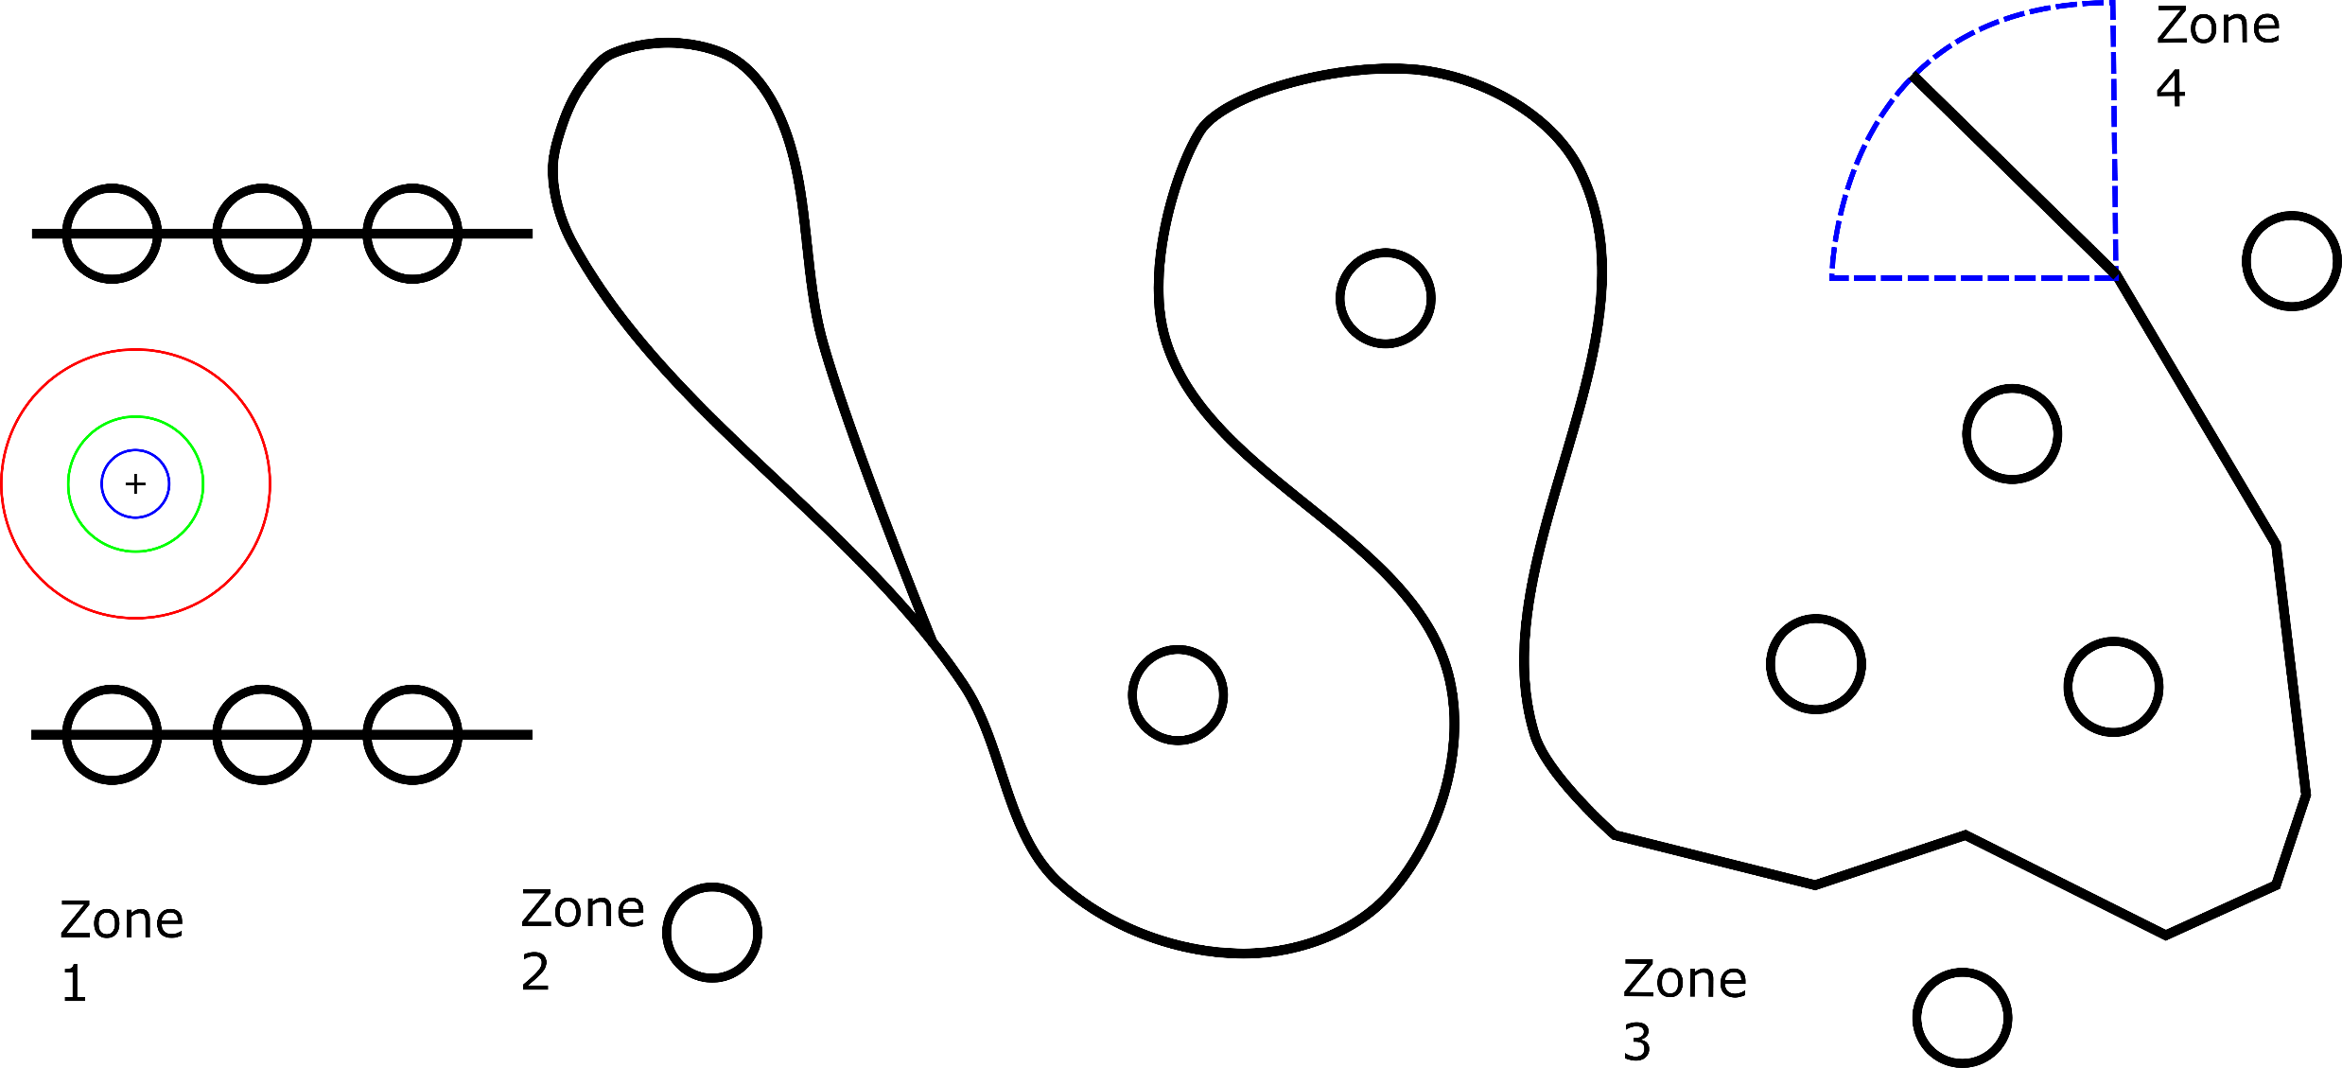
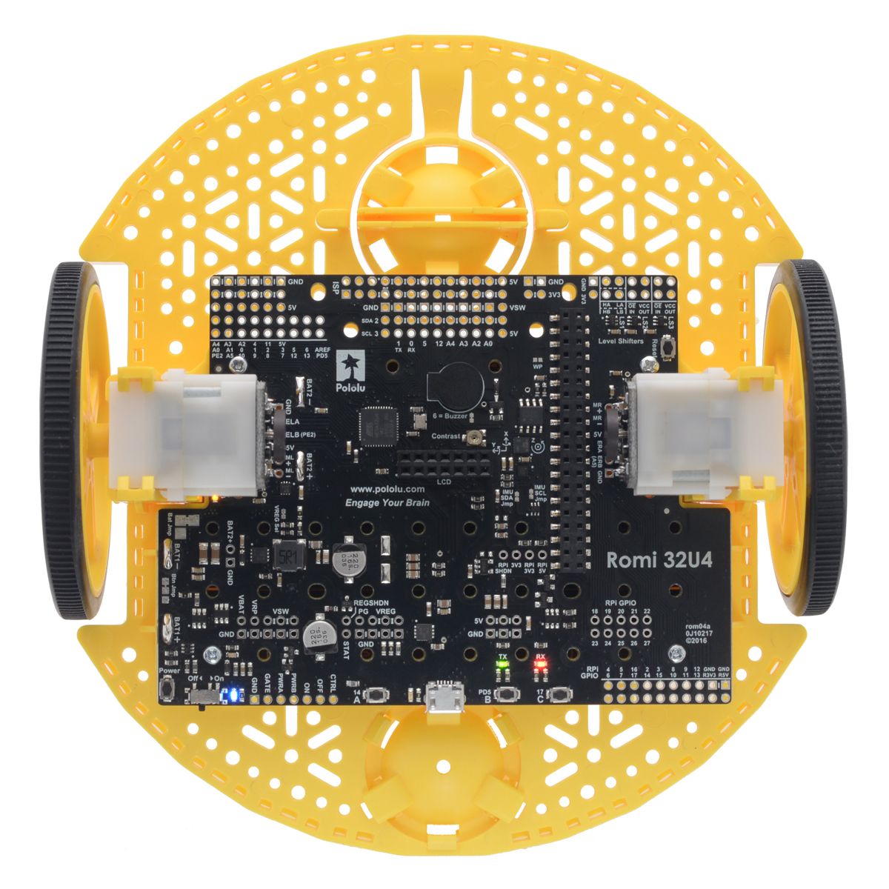
Reminder: Assessment 1
Notes:
These are the tasks our robot has to complete:
Move in a straight line (30 points)
Find the start of a line of follow it
Determine when you have reached the end of the line (5 points)
Return to and stop at the starting location

Slide 6
Decomposing the Problem
Driving Straight
Finding Line
Calibrating Line Sensors
Joining Line
Line Following
Following Line
Catching Loss of Line
Identifying Line Terminus
Sense of Time?
Confidence in Line End
Sense of Line Continuity?
Going Home
Notes:
For each,
what do we need to know to achieve them?
What can we use to achieve them (how)?

Slide 7
Decomposing the Problem
Driving Straight
Finding Line
Calibrating Line Sensors
Joining Line
Line Following
Following Line
Catching Loss of Line
Identifying Line Terminus
Sense of Time?
Confidence in Line End
Sense of Line Continuity?
Going Home
“Human Perspective”
“Robot Perspective”
(semantic / behavioural)
(numerical)
Notes:
For each,
what do we need to know to achieve them?
What can we use to achieve them (how)?

Slide 8
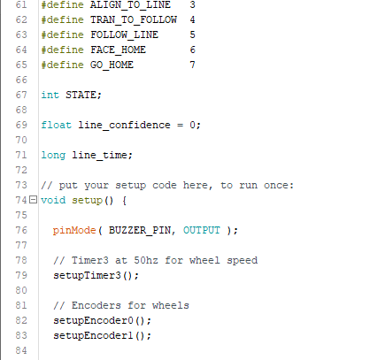
Decomposing the Problem
Driving Straight
What we want to observe
Finding Line
Calibrating Line Sensors
Joining Line
Description in code
Line Following
Following Line
Catching Loss of Line
Identifying Line Terminus
Sense of Time?
Confidence in Line End
Sense of Line Continuity?
Going Home
“Human Perspective”
“Robot Perspective”
(semantic / behavioural)
(numerical)
Notes:
For each,
what do we need to know to achieve them?
What can we use to achieve them (how)?

Slide 9
Dependency of a Robotic System
Mission Planner
Position Tracking
Closed Loop Motion Control
( on time )
Read Sensors / Drive Actuators

Slide 10
This Lecture:
Decomposing Problems
What is a microcontroller/computer?
Register Access
Using an Interrupt
Notes:
The learning outcomes for this lecture are to:
Grasp a fundamental (deep) understanding of how we use microcontroller peripherals like Timers, Interrupts, etc.
This means knowing something of how computers work…
…and why we then write software the way we do.
Ordinarily, this is difficult to grasp by ‘just doing it’, it needs to be taught.
We will also looks at how it is done on Arduino (surface level understanding).
You should be able to apply all this in the lab session.
Hopefully, the strange software will make more sense after this.

Slide 11
What is a microcontroller / computer?
Notes:
Ask the audience for some definitions of computers (set context):
What they are
What they do
Why they are useful.

Slide 12
What parts build a computer?
Notes:
Ask audience to outline components of a computer, in order to break down ‘computer’ into the idea of a computer being made of many parts.

Slide 13
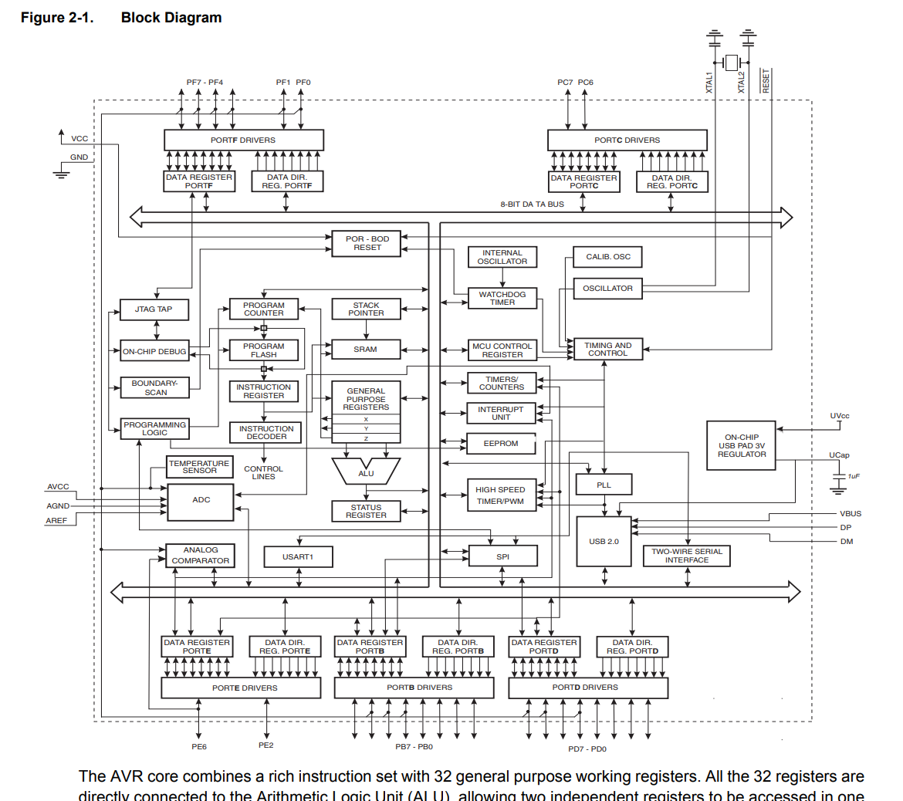
AVR Atmega 32u4
Notes:
This is the block diagram for the 32u4 – which is the microcontroller we are working with.
What is the difference between a micro-controller and a micro-processor?
The Printed Circuit Board this chip is mounted on fits within the Arduino ecosystem/community, e.g., the pins of the microcontroller are labelled with the definitions created by Arduino. Therefore, we can use Arduino libraries and the IDE.
But we are going to take a deeper look, and write some of our own code for this chip.

Slide 14
AVR Atmega 32u4
Notes:
This red circle is the electronic symbol for a Crystal.
The Crystal circuit creates a precise oscillation, for this board, 16Mhz.
What would happen if the clock speed were to vary?

Slide 15
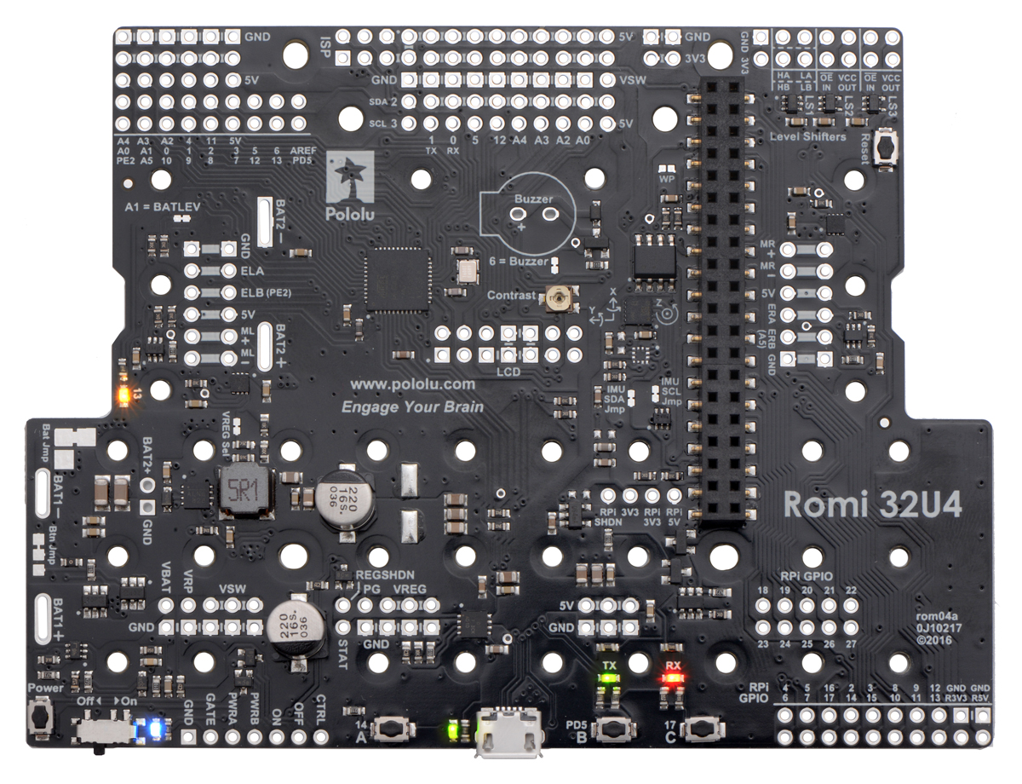
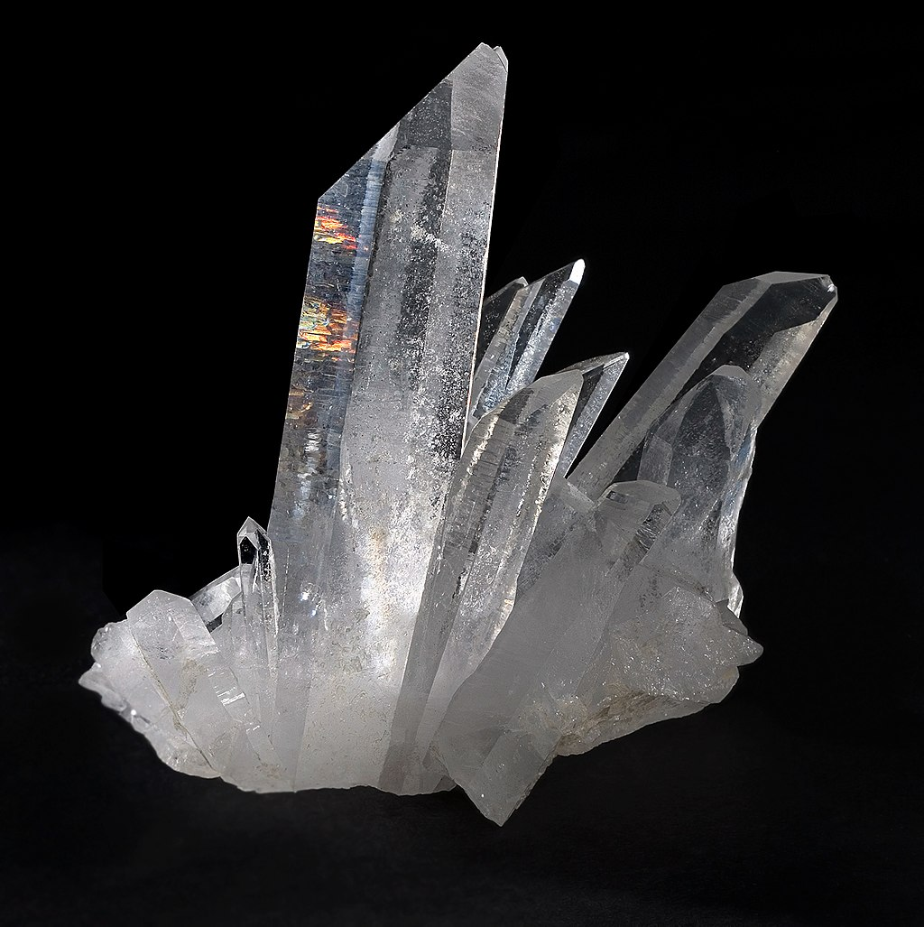
Quarts:
Piezo effect
16Mhz
Notes:
This is where the crystal is on the Romi board.

Slide 16
16Mhz
Notes:
And this is the Microcontroller Chip (34u2)

Slide 17
16Mhz
Notes:
Why might the Crystal and Microcontroller be so close to each other?
You will almost always find it to be this way.

Slide 18
AVR Atmega 32u4
Notes:
Lets look at the block diagram again.
All these parts, all the blocks, are inside the chip.

Slide 19
Notes:
The block diagram fits inside the chip.

Slide 20
Notes:
And the rest of the board is mostly electronics to support the chip, and at a physical size that is useful so we can plug things in.

Slide 21
Analog and Digital
pinMode( n, INPUT );
pinMode( n, OUTPUT );
analogRead( );
analogWrite( );
digitalRead( );
digitalWrite( );
Tell the microcontroller the ‘direction’ of a pin.
We need to configure the microcontroller in setup() {…}
Transform a continuous voltage into a digital encoding.
Transform a digital encoding into a continuous voltage.
Measure voltage against threshold, true or false (HIGH/LOW)
Set voltage HIGH/LOW

Slide 22
Quick Look at the Analog-to-Digital Converter (ADC)

Slide 23
AVR Atmega 32u4
Notes:
Lets look at the block diagram again.
All these parts, all the blocks, are inside the chip.

Slide 24
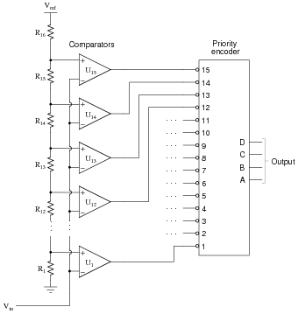
analogRead( A0 );
?
?
8-Bit ADC ?
10-Bit ADC ?
?
01001101
?
( 77 )
?

Slide 25
Closer look at the Digital Pins.

Slide 26
AVR Atmega 32u4
Notes:
This part of the diagram is labelled as ‘PORTF Drivers’.
It represents a set of pins on the chip.

Slide 27
Notes:
On the board, these pins are then wired (printed circuit board traces) to a set of big pins on the board.
Really, the circuit board is mapping the microchip to physical pins that are large enough for us to use!
If you look closely, you can even see the lines on the circuit board.

Slide 28
This bit is the
‘computer’.
We can think of the
rest as peripherals.
Notes:
Looking at the Block diagram again:
This green area is really the ‘computer’ – the bit which manipulates numbers (0’s and 1’s).
Does anyone know what an ALU is?
…Stack?
If you want to know more, a good place to start is the Von Neumann architecture.
https://en.wikipedia.org/wiki/Von_Neumann_architecture

Slide 29
Central Processing Unit
(transforming numbers)
INPUT
OUTPUT
Notes:
We can think of using a computer as:
Taking in ‘input’
Making some transformation of inputs.
Note, computers can also ‘remember’ as part of the transformation process.
Creating ‘outputs’.

Slide 30
Central Processing Unit
(transforming numbers)
INPUT
OUTPUT
( a robot? )
Notes:
If the output of the computer has an effect on the input, does this automatically make it a robot?
If not, what is a key distinction?

Slide 31

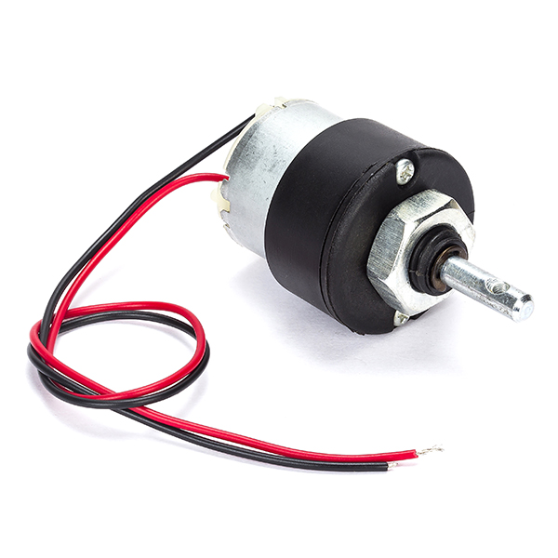
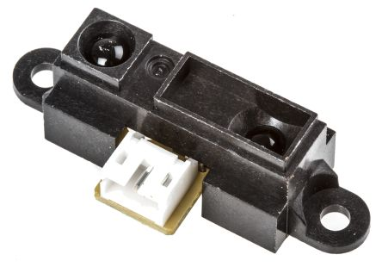
Central Processing Unit
(transforming numbers)
INPUT
OUTPUT
Notes:
For Robots, we expect to have sensors as inputs, and actuators as outputs.
Microcontrollers are everywhere.
The Shape Rangefinder on the left has its own microcontroller to process the infrared signal.
This idea of [ input -> process -> output ] happens within most devices.

Slide 32
From the point of
view of the CPU,
All of the blue is
input and output
(and it is all digital)
Notes:
The blue bit is all peripherals – extra devices the computer can use.
These include:
Analog to Digital Converter (ADC)
Temperature Sensor
Timers, Counters & Interrupts
Data Ports (pins to read or write values)

Slide 33
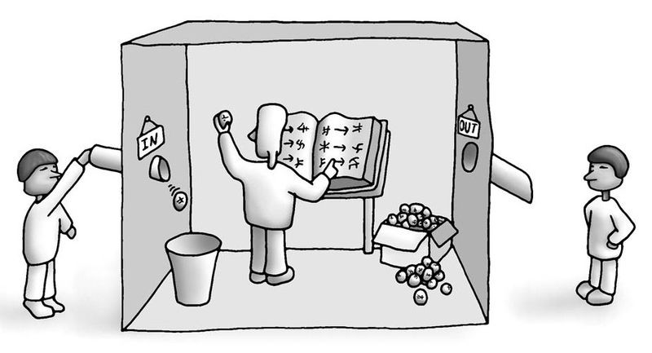
https://commons.wikimedia.org/wiki/File:2-chinese-room.jpg, accessed 10/12/18
Notes:
We can think of a computer as a bit like a translation machine.
It takes numbers as inputs.
It performs transformations on the numbers using ‘operation codes’ (which we program)
It produces numerical outputs, represented (or stored) as electronic signals/states.

Slide 34
This Lecture:
Decomposing Problems
What is a microcontroller/computer?
Register Access
Using an Interrupt
Notes:
The learning outcomes for this lecture are to:
Grasp a fundamental (deep) understanding of how we use microcontroller peripherals like Timers, Interrupts, etc.
This means knowing something of how computers work…
…and why we then write software the way we do.
Ordinarily, this is difficult to grasp by ‘just doing it’, it needs to be taught.
We will also looks at how it is done on Arduino (surface level understanding).
You should be able to apply all this in the lab session.
Hopefully, the strange software will make more sense after this.

Slide 35
Register Access

Slide 36
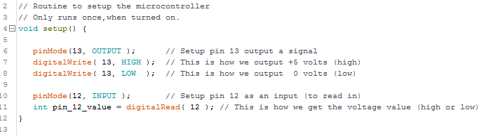
Example:
Setting a pin to output/input with Arduino code
Notes:
This code uses the functions defined by the Arduino environment.
We will explore what is going on beneath them.

Slide 37
Notes:
To read and write to pins, the CPU has to activate peripheral hardware.
The block I have highlighted blue is repeated in this block diagram.
The chip is 8bit, which means that most of the hardware is accessed and controlled using 8bits of memory.
The block I have highlighted blue controls 8 physical pins on the chip.

Slide 38
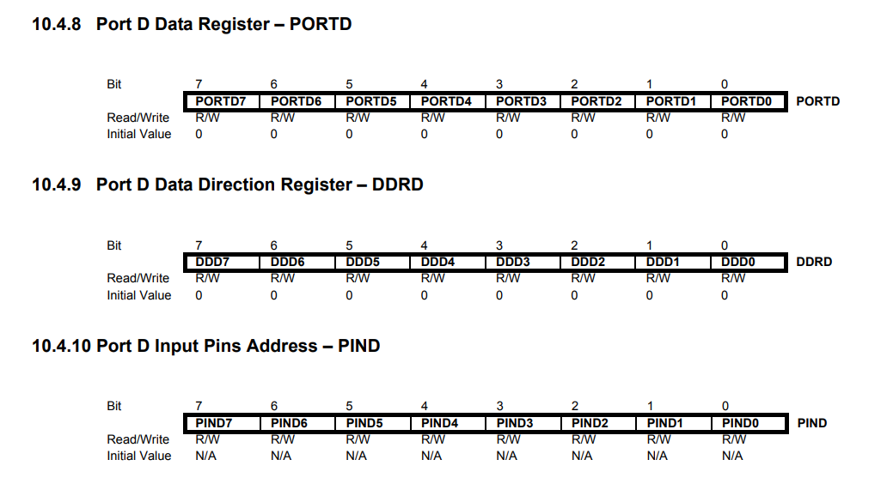
Inside the manual…

Slide 39
Notes:
To read and write to pins, the CPU has to activate peripheral hardware.
The block I have highlighted blue is repeated in this block diagram.
The chip is 8bit, which means that most of the hardware is accessed and controlled using 8bits of memory.
The block I have highlighted blue controls 8 physical pins on the chip.

Slide 40
Where the value to
read or write
is set and stored.
Where the direction
in or out
is set and stored.
Circuit to
write or buffer
voltages
Actual pins on the chip
Notes:
Here we can see a closer look at the block which controls the pins.
We can see that there are registers associated to this block.
A register is a portion of memory that is used to control the electronics (hardware).

Slide 41
Where the value to
write
is set and stored.
Notes:
This register stores the state we wish the pin to be in if it is an output.

Slide 42
Where the direction
in or out
is set and stored.
Notes:
This register configures a pin to be either input, or output.

Slide 43
Where the value
read
stored.
Notes:
Another register is located here which stores the last value read as an input.
Why might input and output states be stored in different registers?

Slide 44
8 bits that match
Up to 8 pins
Output high
or low (?)
Input or
Output (?)
Input
High or low (?)
Notes:
We can see all three registers used to perform the Arduino functions:
pinMode( );
digitalWrite( );
digitalRead( );

Slide 45
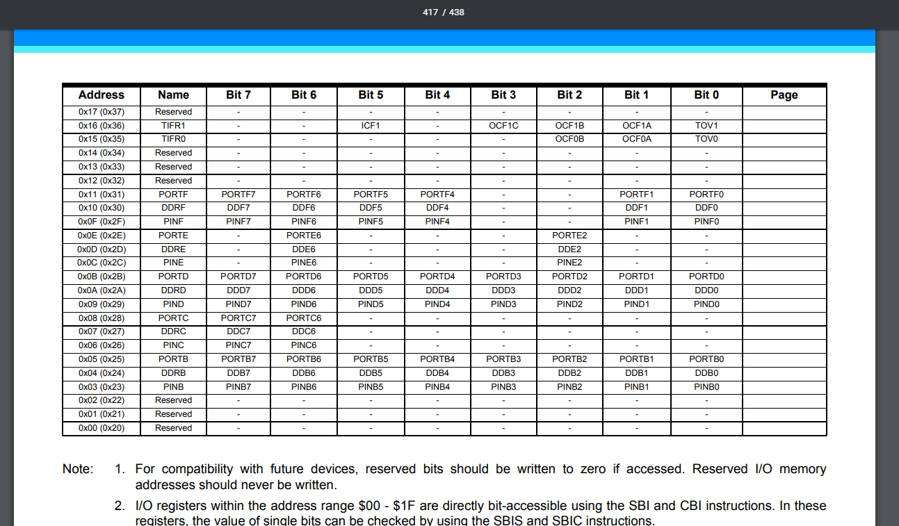
Notes:
So, a register is a place in memory. Where?
If we want, we can find out in the manual.
These memory addresses are fixed! They are set by the manufacturer.
Generally, it is better to use them by referring to keyname they are given, like PORTD, DDRD, PINE etc. These keywords reference the address.

Slide 46
Direct access in C using a pointer:
Notes:
If we were going to access them directly, this is the type of C syntax we would need to use.
We won’t go further into this.

Slide 47
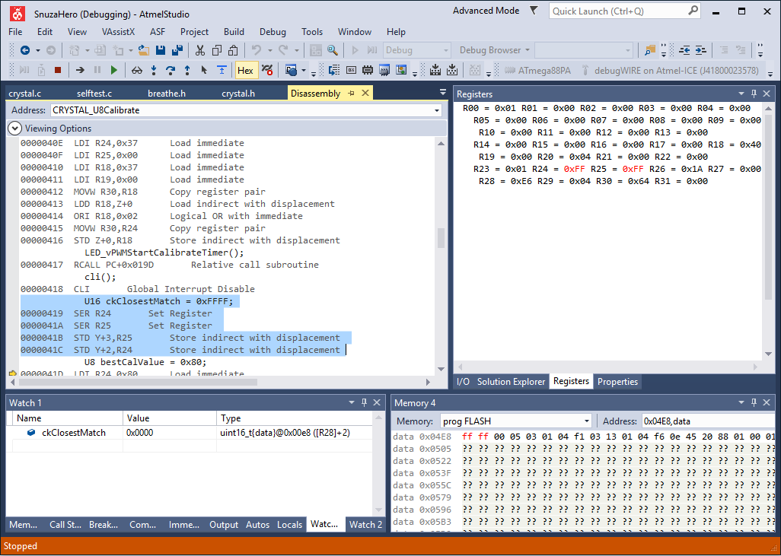
Notes:
Microcontrollers have a big block of memory.
A portion of this is reserved for the control registers.
In a more sophisticated Integrated Development Environment (IDE), it is possible to view the memory blocks directly.
So memory is essentially a big table of numbers.
Some are registers, the rest are program space.

Slide 48
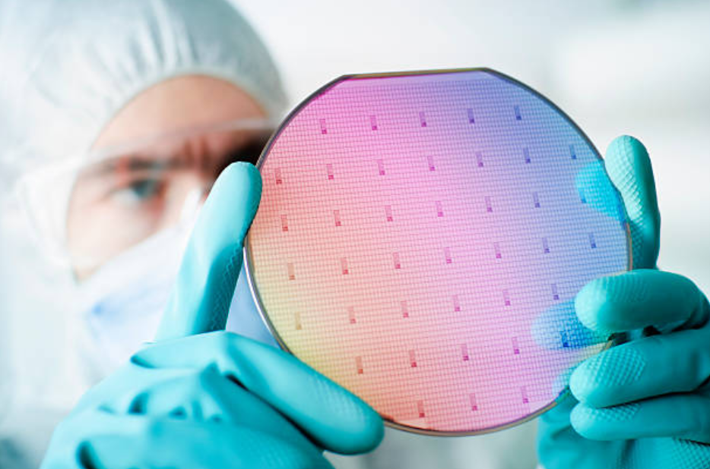
Notes:
Chips are manufactured on big silicon wafers like this.
http://kremesti.com/semiconductor_chip_manufacturing.html
Image from: https://www.istockphoto.com/gb/photos/silicon-chip-wafer?mediatype=photography&phrase=silicon%20chip%20wafer&sort=mostpopular

Slide 49
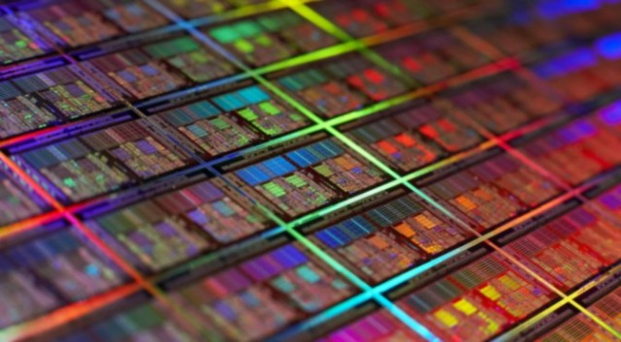
Notes:
A closer look shows something of their structure.

Slide 50
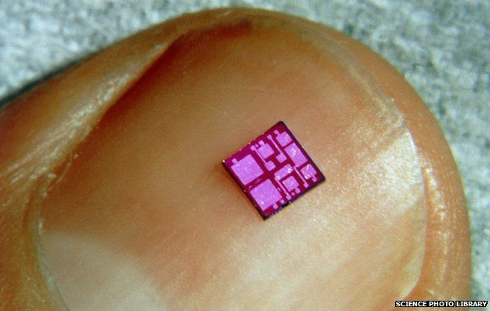
Notes:
Notice the two large blocks – these are probably the memory of the chip.
Memory is just large arrays of millions of transistors, like a look up table.

Slide 51
What we had before:
Notes:
This is the code we had before.

Slide 52
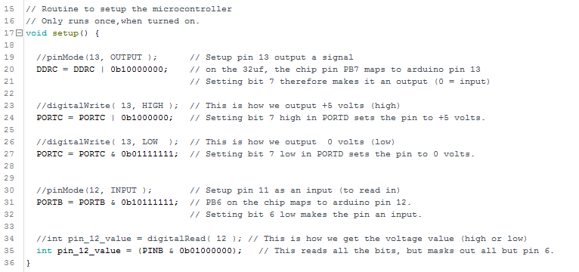
The same thing, with direct access to registers:
Notes:
This is how to achieve the same thing by writing 0’s and 1’s into the registers themselves.
Generally this is not advised.
The Arduino environment is so successful because code written in Arduino (generally) works on all their different boards.
This is because calls like digitalWrite() have a lot of clever code behind them to make sure that different machine code is generated for different chips.
However it should be interesting to know what is going on when you make a call like digitalWrite() – it is not magic. Those 0’s and 1’s are turning transistor circuits on and off. If you want, you can find the exact memory locations in the manual!

Slide 53
This Lecture:
Decomposing Problems
What is a microcontroller/computer?
Register Access
Using an Interrupt
Notes:
The learning outcomes for this lecture are to:
Grasp a fundamental (deep) understanding of how we use microcontroller peripherals like Timers, Interrupts, etc.
This means knowing something of how computers work…
…and why we then write software the way we do.
Ordinarily, this is difficult to grasp by ‘just doing it’, it needs to be taught.
We will also looks at how it is done on Arduino (surface level understanding).
You should be able to apply all this in the lab session.
Hopefully, the strange software will make more sense after this.

Slide 54
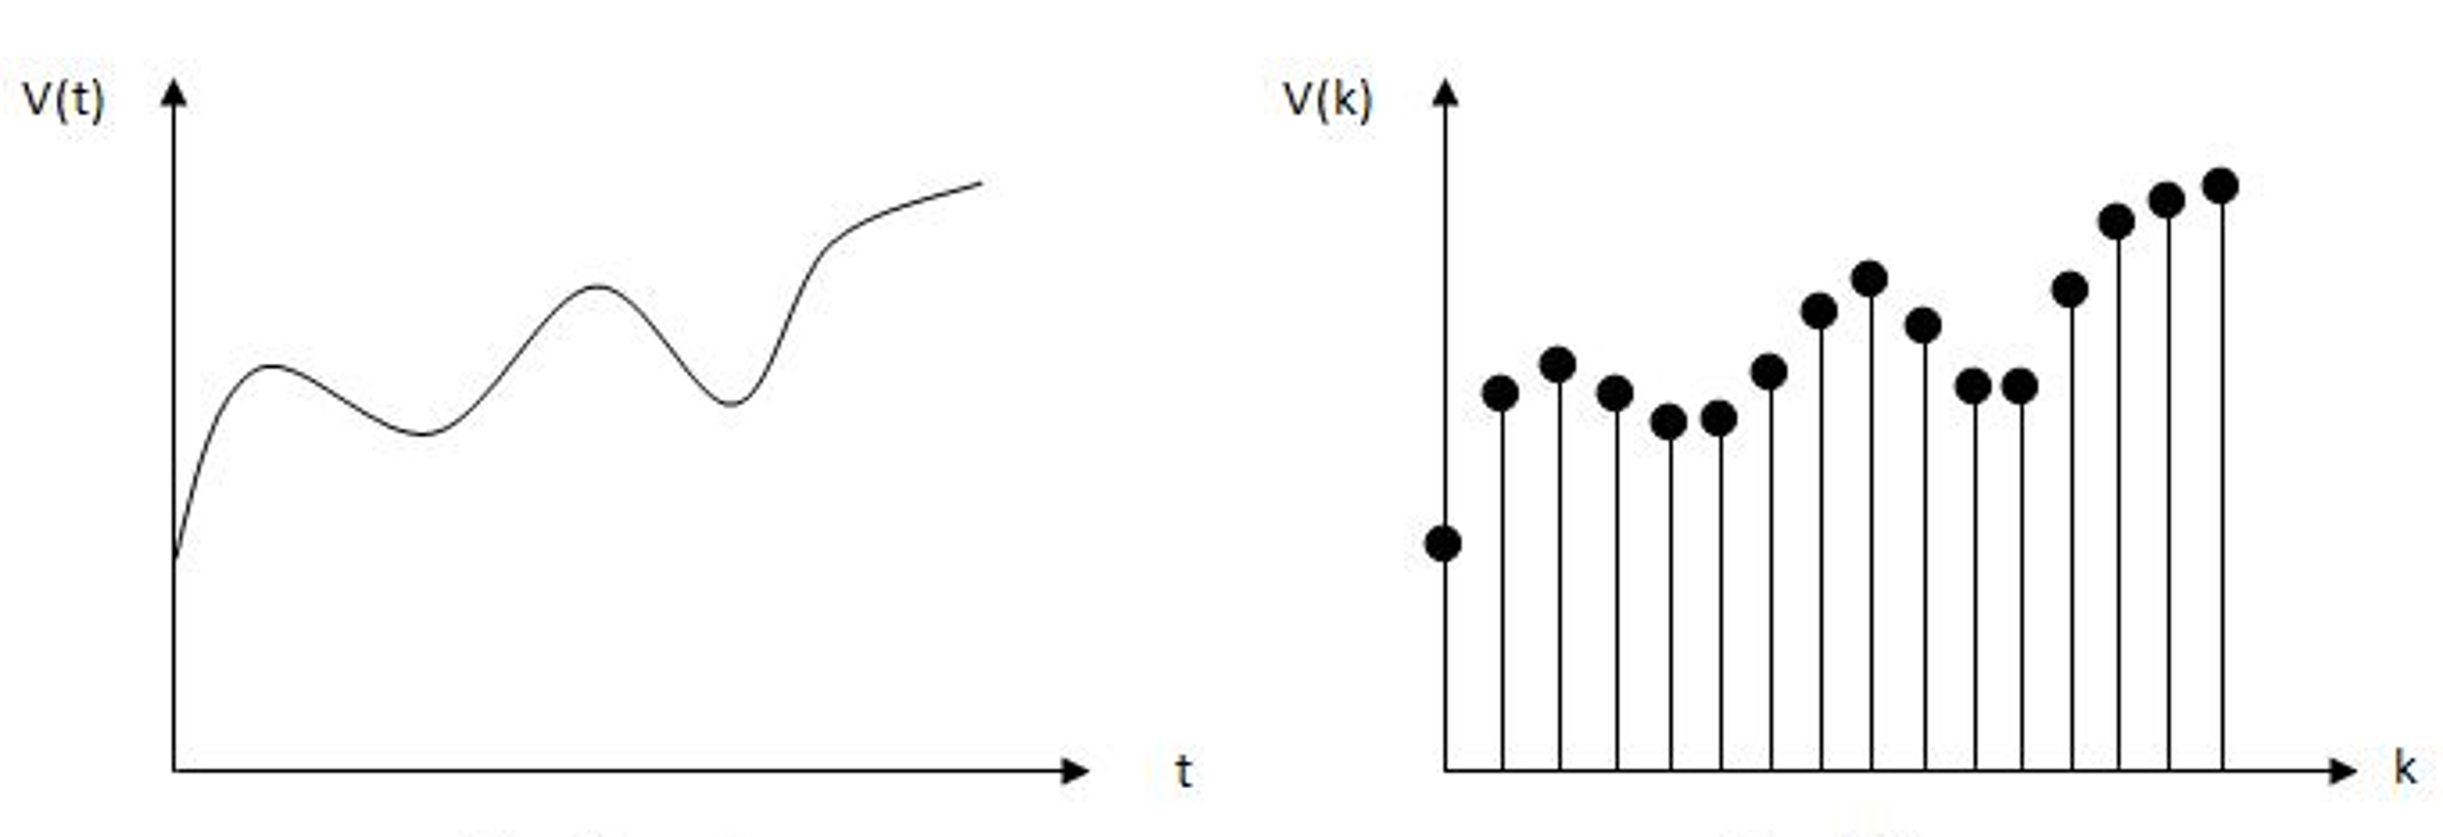
Notes:
The graph on the left could be various sensor information:
Sound
Speed of a robot
Radio signal
We can reconstruct this signal using a digital representation, like on the right.
It is important the representation is consistently timed.

Slide 55
Notes:
We can see here, if the samples are irregularly timed, we lose important information.
This loss of information will result in error that integrates over time.
If the graph on the left was the speed of the robot, then we would quickly lose track of our integrated position.

Slide 56
CPU is going
setup and use
Timer3
Notes:
Fortunately, a microcontroller has a unit designed to run code at precise time intervals.
They are called timers.

Slide 57
…Hey!
Timer3 is then
going to interrupt
the CPU’s normal
operation with a set
frequency
Notes:
A timer keeps track of time, and then raises an interrupt flag, which causes the microcontroller to run an Interrupt Service Routine.
You can think of an ISR as a piece of code that runs like a background task.

Slide 58
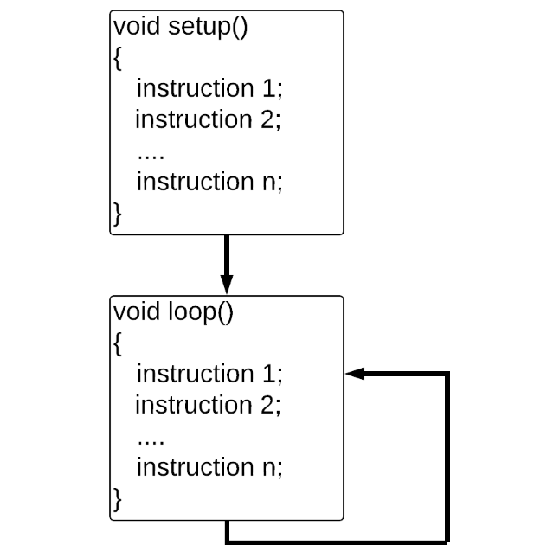
Notes:
This is the Arduino sketch we have seen so far.
It has a setup which runs once.
And a loop which iterates itself forever.

Slide 59
ISR( TIMER3_COMPA_vect ) {
instruction 1;
instruction 2;
…
}
Notes:
An interrupt can break the flow of the loop to run important code.

Slide 60
Timer3
@2Hz
…Hey!
…Hey!
…Hey!
1, 2, 3, 4, 5, 6, 7,
8, 9, 10, 11, 12,
13, 14, 15, 16, 17
CPU
Loop()
Code
Interrupt Service
Routine
Loop()
Code
Interrupt Service
Routine
Loop()
Code
Interrupt Service
Routine
16Mhz
Time
0 Second
1.5 Seconds
Notes:
The Timer is attached to the CPU, and so it uses the 16mhz clock of the cpu.
The timer has to be configured to run either at 16mhz, or slower.

Slide 61
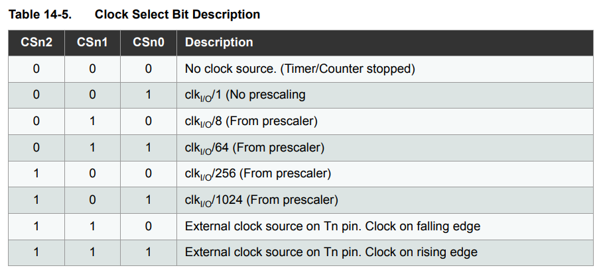
Prescaler
clk _{I/o}
= 16 MHz
Timer Frequency:
0 Hz
16 MHz
2 MHz
250 KHz
62.5 KHz
15.625 KHz
?
?
f_{timer} = f _{i/o} / prescaler

Slide 62
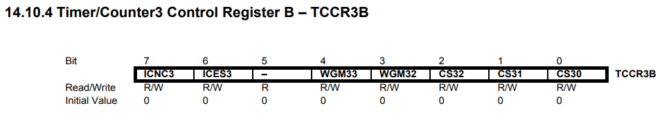
TCCR3B = 0B00000101

Slide 63
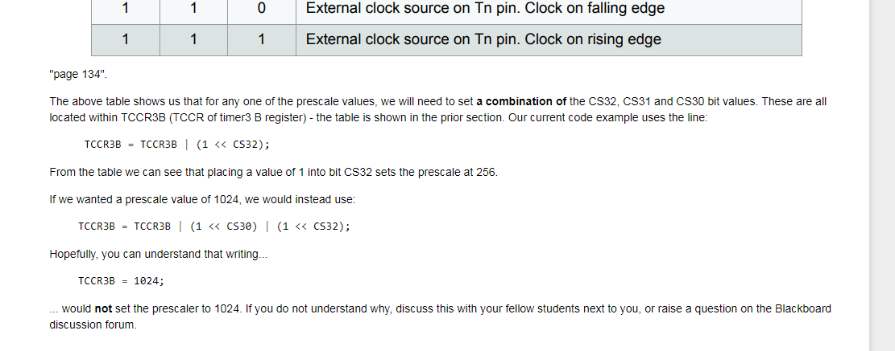
TCCR3B = 1024;

Slide 64
Setting a specific frequency
Timer Frequency:
0 Hz
16 MHz
?
2 MHz
250 KHz
62.5 KHz
15.625 KHz

Slide 65
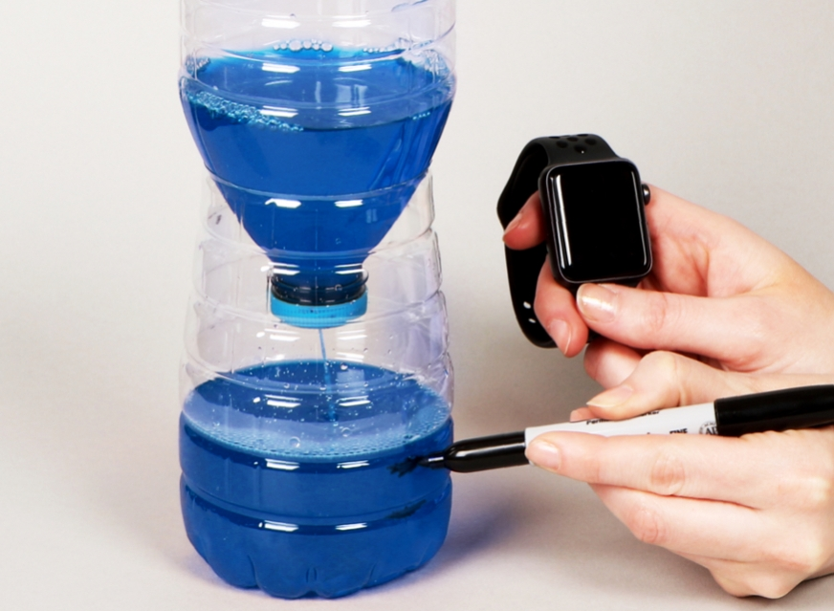
Setting a specific frequency
Prescaled Timer Frequency:
16 MHz
?
2 MHz
250 KHz
62.5 KHz
ISR
15.625 KHz
( count up to a value we specify )

Slide 66
Setting a specific frequency
Prescaled Timer Frequency:
16 MHz
2 MHz
250 KHz
Another Register:
OCR3A
16 Bits
Max value: 65,536
62.5 KHz
15.625 KHz

Slide 67
f_{timer} = f _{i/o} / prescaler

Slide 68
f_{timer} = f _{i/o} / prescaler
f_{desired} = f_{timer} / OCR3A

Slide 69
f_{timer} = f _{i/o} / prescaler
f_{desired} = f_{timer} / OCR3A
OCR3A = f_{timer} / f_{desired}

Slide 70
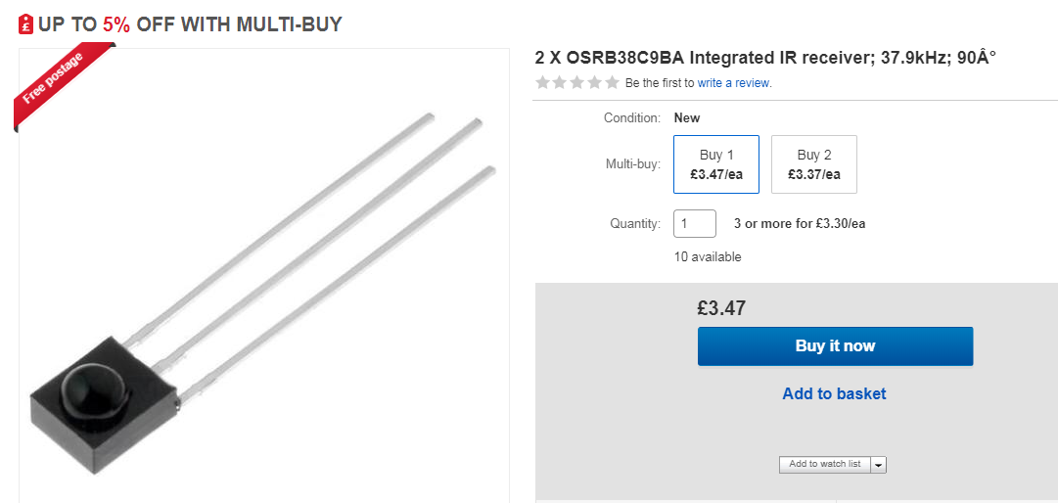
Example

Slide 71
Prescaler
clk _{I/o}
= 16 MHz
Timer Frequency:
0 Hz
16 MHz
2 MHz
250 KHz
62.5 KHz
15.625 KHz
?
?
f_{timer} = f _{i/o} / prescaler

Slide 72
2000000 = 16000000 / 8
Max = 65536
f_{desired} = f_{timer} / OCR3A
OCR3A = f_{timer} / f_{desired}
OCR3A = 2000000 / 37900
53
OCR3A = 52.7
Min = 0
OCR3A

Slide 73
Blink LED
@37.9Khz
…Hey!
…Hey!
…Hey!
Timer3
2Mhz
Prescale 8
OCR3A = 53
1, 2, 3, 4, 5, 6, 7,
8, 9, 10, 11, 12,
13, 14, 15, 16, 17
CPU
Loop()
Code
Interrupt Service
Routine
Loop()
Code
Interrupt Service
Routine
Loop()
Code
Interrupt Service
Routine
16Mhz
Time
0 Second
Notes:
The Timer is attached to the CPU, and so it uses the 16mhz clock of the cpu.
The timer has to be configured to run either at 16mhz, or slower.

Slide 74
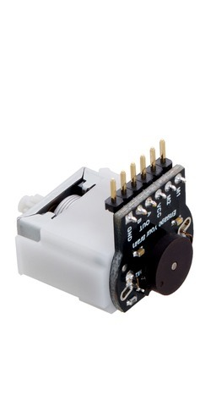

Slide 75
Wheel
Rotation
…Hey!
…Hey!
…Hey!
1, 2, 3, 4, 5, 6, 7,
8, 9, 10, 11, 12,
13, 14, 15, 16, 17
CPU
Loop()
Code
Interrupt Service
Routine
Loop()
Code
Interrupt Service
Routine
Loop()
Code
Interrupt Service
Routine
16Mhz
Time
0 Second
Notes:
The Timer is attached to the CPU, and so it uses the 16mhz clock of the cpu.
The timer has to be configured to run either at 16mhz, or slower.

Slide 76
To Summarise

Slide 77
Dependency of a Robotic System
Mission Planner
Position Tracking (Labsheet 8)
PID Feedback Control (Labsheet 6)
( on time )
Track Wheel Rotation (Labsheet 4)

Slide 78
Dependency of a Robotic System
Mission Planner
Position Tracking (Labsheet 8)
(time known)
PID Feedback Control (Labsheet 6)
( on time )
Track Wheel Rotation (Labsheet 4)

Slide 79
Dependency of a Robotic System
Mission Planner
In good time
Position Tracking (Labsheet 8)
(time known)
PID Feedback Control (Labsheet 6)
( on time )
Track Wheel Rotation (Labsheet 4)

Slide 80
Dependency of a Robotic System
When Necessary
Mission Planner
In good time
Position Tracking (Labsheet 8)
(time known)
PID Feedback Control (Labsheet 6)
( on time )
Track Wheel Rotation (Labsheet 4)

Slide 81
Questions
Anonymous Feedback form:
https://forms.gle/PyQQy2mwzyATFmJW6
Padlet board (questions & comments):
http://padlet.com/paul_odowd1/1lhoodwv2fuc

